Slide 1
VirtualMC module latency
Will collaborate with Convey
How we understand the problem (from analyzing infrastructure code):
TLB translate virtual memory addresses to physical addresses
Delay is not consistent (e.g., long delay can be caused by TLB miss)
Possible solutions:
Statistical model?
Increase page-table size to minimize TLB misses?
Notes:
TLB Translation Lookaside Buffer – a memory cache to translate virtual address to physical address

Slide 2
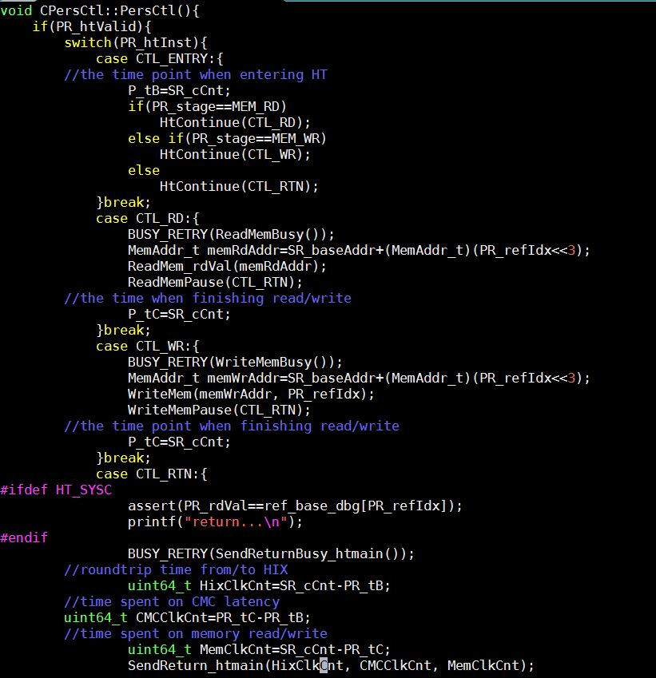
Measure B’
Operations | A’ (ns) | B’ (cycles) | C’ (cycles) | F’ (cycles)
Single memory read | 1058559 | 168.4414 | 4 | 164.4414
Single memory write | 1057302 | 175.6587 | 4 | 171.6587
starting time of B’
ending time of B’
latency B’
B’ is measured in HT code
Starting point of CMC
Ending point of CMC

Slide 3
Measure C’
Operations | A’ (ns) | B’ (cycles) | C’ (cycles) | F’ (cycles)
Single memory read | 1058559 | 168.4414 | 4 | 164.4414
Single memory write | 1057302 | 175.6587 | 4 | 171.6587
starting time of B’ & C’
ending time of C’
C’ is measured in HT code
Starting point of CMC logic
Ending point of CMC logic
latency C’

Slide 4
Measure F’
Operations | A’ (ns) | B’ (cycles) | C’ (cycles) | F’ (cycles)
Single memory read | 1058559 | 168.4414 | 4 | 164.4414
Single memory write | 1057302 | 175.6587 | 4 | 171.6587
ending time of C’;
starting time of F’
F’ is measured in HT code
Point of issuing memory request
Point of receiving memory response
ending time of B’
latency F’

